Slide 1

Improving Performance with Statistics
Notes:
Intro: my name is, my role is, …

Slide 2
Agenda
Impact of Statistics on Performance (Why should you ANALYZE)
Collecting statistics about the database (EXPLAIN ANALYZE)
Improving performance by using ANALYZE
Increasing sampling and statistics
Identifying when it is best to use ANALYZE
Notes:
Instructor Notes: Quick tour of the entire unit
Are the statistic stale?
It has been a long time since last analysis – time may not be the most important factor, data distribution is!
It has been analyzed and your plan is not working well it is time to re-analyze.
There is no staleness index.
Explain analyze - maps back to the explain.
Should be receiving examples for this
shows estimated rows and the actual rows.
it tells you how many rows comes out from each segment and how much memory it takes.
plan checker tool
Do not increase the 25 distinct values
It will become very slow.
don’t change it.
if you have issues create a support ticket.
Maybe it is better to explain it as up to 25 distinct values.

Slide 3
Impact of Statistics on Performance
Pivotal Legacy Query Optimizer and Pivotal Query Optimizer generate the best possible plan in the search space of valid execution plans, based on costing.
The costing of a query plan is dependent on the operators, as well as the cardinality estimation of the input to the execution node/operator.
Number of distinct values for a given column will determine the estimated skew of that particular column, which will then influence whether we broadcast the tuples or redistribute.. Whether we pick stream aggregation vs. Hash aggregation
Cardinality estimation is built on top of the statistics on the base table

Slide 4
When should you run ANALYZE
Whenever the statistics are stale
How do you know? You don't!
The view in gp_toolkit is based on time not data distribution
So, if the new data you are loading has the same distributional characteristics as the current data – you probably don't need to run ANALYZE
Otherwise, run ANALIZE
Notes:
Instructor Note: What does DISTRIBUTION of the data mean here
What does DISTRIBUTION mean here - it means the top 25 most frequent values in any column and the probability of that appearing - for many data types, GP collects/creates histogram boundaries (equi-depth buckets => all have the same number of observations)
This info is in the table (get table reference from venky - maybe pg_stats - like slide 5), but you have to know how to read and interpret the table
Additionally, all statistic collection in GP is column based - but not across multiple columns - so it is only single columns. There is no cross-correlation between columns (eg. if we have a column of car types [Camry, Accord,...] and a column of Manufacturer [Toyota, Honda, …] there is no cross-column (or correlation) statistics and GP doesn’t know that a Camry is related to Toyota via the statistics. Of course we know that – but it is a function of our relational concepts and tables that we create. Statistics collection is at a lower level than schema concepts.
Multi-dimensional histograms are extremely slow and costly - don’t do them - and not in the roadmap at the moment. 2016/11/18
Sampling
Only the top 25 most frequently occurring values are recorded and the probability of them appearing in the data
For many data types, while we collect these top 25 and build a distribution boundary (and store it), the min/max may be outside this histogram (data skew)
Everything is based on sampling the rows - so the distribution boundaries aren’t perfect, but they give sufficient information to the planner (as long as the stats are not stale) so that the planner can determine exceptionally good execution plans
Best practice - if you have an existing query that sudden slows down disproportionately after you add new data, then your new data likely has a different distribution to it and you should run ANALYZE

Slide 5
ANALYZE and Database Statistics
Database statistics:
Are used by the optimizer and query planner
Should be updated with ANALYZE:
After loading data (COPY, GPLOAD, gpfdist, …)
After large INSERT, UPDATE, and DELETE operations
After CREATE INDEX operations
After database restores from backups
Notes:
The Greenplum database uses a cost-based query planner that relies on database statistics. The ANALYZE command collects statistics about the database needed by the query planner to determine the most efficient way to execute a query.
It is very important that the database has up-to-date statistics for optimal query performance. As a database or system administrator this is the most important ongoing administrative database maintenance task.
It is highly recommended to run ANALYZE:
After data loads – particularly COPY, GPLOAD, gpfdist, or other data loading mechanisms
After large INSERT, UPDATE, and DELETE operations
After CREATE INDEX operations
After completing a database restore from backups
The pg_statistic system catalog table stores statistical data about the contents of the database. Entries are created by ANALYZE and subsequently used by the query planner. There is one entry for each table column that has been analyzed. The pg_statistic system catalog also stores statistical data about the values of index expressions.

Slide 6
EXPLAIN ANALYZE Estimated Costs
EXPLAIN ANALYZE provides cost estimates for the execution of the plan node as follows:
Cost – Measured in units of disk page fetches
Rows – The number of rows output by the plan node
Width – Total bytes of all the widest row of the rows output by the plan node
Notes:
Query plans display the node type along with the planner estimates including cost, rows and width for the execution of that plan node.
Cost is a relative measured in units of disk page fetches. The value 1.0 equals one sequential disk page read. The first estimate is the cost of getting the first row and the second is the total cost of getting all rows in milliseconds. The total cost assumes that all rows will be retrieved, which may not always be the case if using a LIMIT clause for example.
Rows are the total number of rows output by the plan node. This is usually less than the actual number of rows processed or scanned by the plan node, reflecting the estimated selectivity of any WHERE clause conditions.
The width is the total bytes of the widest row of all the rows output by the plan node.
It is important to note that the cost of an upper-level node in the plan tree includes the cost of all its child nodes. The topmost node of the plan has the estimated total execution cost for the plan.
The cost does not consider the time spent transmitting results to the client.

Slide 7
Example
create table toy (a int, b int);
insert into toy select i%10, i from generate_series(1,100) I;
student=# explain analyze select * from foo where a < 10;
QUERY PLAN
---------------------------------------------------------------------------------------------------------
Gather Motion 3:1 (slice1; segments: 3) (cost=0.00..1.01 rows=1 width=8)
Rows out: 3 rows at destination with 1.083 ms to end, start offset by 9.047 ms.
-> Seq Scan on foo (cost=0.00..1.01 rows=1 width=8)
Filter: a < 10
Rows out: 3 rows (seg0) with 0.337 ms to first row, 0.345 ms to end, start offset by 9.725 ms.
Slice statistics:
(slice0) Executor memory: 318K bytes.
(slice1) Executor memory: 163K bytes avg x 3 workers, 163K bytes max (seg0).
Statement statistics:
Memory used: 128000K bytes
Optimizer status: legacy query optimizer
Total runtime: 10.233 ms
(12 rows)
Copy the explain analyze into the comment box in http://planchecker.cfapps.io/
Notes:
Instructor Note:
It is important to emphasize the difference between the estimated rows that comes out of an EXPLAIN plan, and the actual rows that comes out of an EXPLAIN ANALYZE.
But it is also equally important to check this against the "plan checker too" at http://planchecker.cfapps.io
Copy and paste the output of the EXPLAIN ANALYZE into this tool to get additional insight.

Slide 8
ANALYZE and VACUUM ANALYZE
The ANALYZE command:
Is used to generate database statistics
Is used to vacuum the database
Can be used on specific table and column names ANALYZE [table [ (column [, ...] ) ]]
The VACUUM ANALYZE command:
Generates database statistics
Can be used on specific table and column names VACUUM ANALYZE [table [(column [, ...] )]]
Notes:
Use the ANALYZE command to generate database statistics. An ANALYZE may be run on the entire table or on specified columns in a table. In large data warehouse environments it may not be feasible to run ANALYZE on an entire database or table due to time constraints. Specifying particular columns to analyze provides the flexibility to generate optimal database statistics for large databases.
Use VACUUM ANALYZE to vacuum the database and generate database statistics. VACUUM ANALYZE performs a VACUUM and then an ANALYZE for each selected table. This is a convenient combination for routine database maintenance scripts.

Slide 9
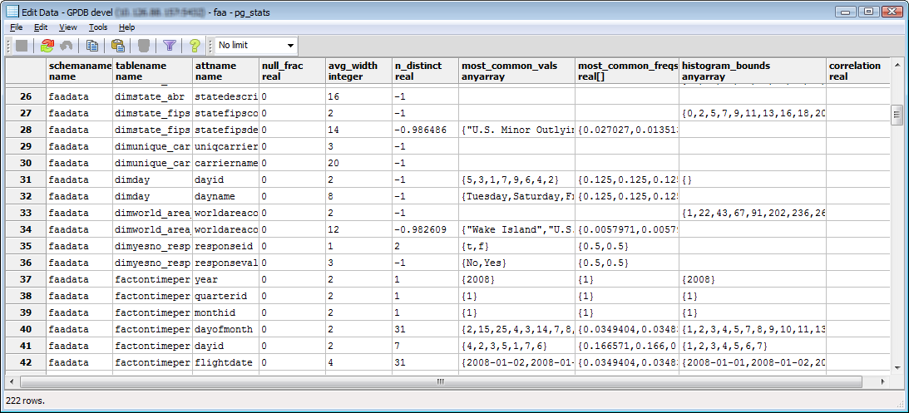
Storage of Statistical Data in pg_stats
Common values (null if no values are more common than others)
Frequency of most common values
Histogram of values divided into groups of almost equal population
Number of distinct non-null values (0 – unknown; < 0 – negative of the fraction of the number of rows; > 0 – number of distinct values
Fraction of column entries that are null
Average stored width (bytes) of non-null entries
Notes:
Statistical information used by the optimizer is stored in the pg_catalog.pg_statistic table. This table stores statistical data for each entry of a table column that has been analyzed with the ANALYZE command. The pg_statistic table is accessible to database superusers as it provides information on all tables within the database. The pg_stats view is a publicly readable view which gives the current user information on tables they have access to. This protects sensitive information by only displaying information on tables the user has read access to.
The statistical columnar data is as follows:
null_frac_real – This column displays the fraction of column entries that are null.
avg_width – The average width of the non-null values of the column is displayed.
Storage of Statistical Data in pg_stats
n_distinct – The number of distinct non-null values is displayed. If the value displayed is 0, the number of distinct values is unknown. If it is less than 0, the value displayed is the negative of the number distinct values divided by the number of rows in the table. The negative value indicates that ANALYZE believes the number of distinct values will increase as the number of rows increases. A positive value indicates the number of possible values for the column.
most_common_vals – The list of most common values is displayed in this column. This column is null if there are no values which are more common than other values.
most_common_freqs – The frequency of the most common values is displayed. This represents the number of occurrences of each divided by the number of rows. The value is null if most_common_vals is null.
histogram_bounds – The column displays the histogram of the list of values that divide the values into groups of approximately equal population. This does not include the values in the most_common_vals column, if it is populated. If the histogram_bounds field is null, this is likely a result of the most_common_vals field representing the entire population.

Slide 10
Use SET STATISTICS to Increase Sampling
Sampling for statistics:
Can be increased for a given column with ALTER TABLE … SET STATISTICS
Defaults to 25 – NOT RECOMMENDED TO CHANGE THIS
May improve query planner estimates for columns used in query predicates and joins (WHERE clause)
Can impact the time it takes to ANALYZE if statistics has larger values – do so at your own peril.
ALTER TABLE customer ALTER customer_id SET STATISTICS 35;
Notes:
Instructor Notes:
For large tables, ANALYZE takes a random sample of the table contents, rather than examining every row to allow large tables to be analyzed in a small amount of time. To increase sampling and statistics collected by ANALYZE use the ALTER TABLE…SET STATISTICS command.
SET STATISTICS can be used to alter the statistics value for a particular table column. This is recommended for columns frequently used in query predicates and joins. The default statistics value is 25. This default value is set with the default_statistics_target parameter.
Setting the statistics value to zero disables collection of statistics for that column. It may be useful to set the statistics value to zero for columns that are never used as part of the WHERE, GROUP BY, or ORDER BY clauses of queries, since the query planner has no use for statistics on such columns.
Larger values increase the time needed to do ANALYZE, but may improve the quality of the query planner's estimates.

Slide 11
The default_statistics_target Parameter
The default_statistics_target parameter:
Is used to increase sampling for statistics collected for ALL columns
Can improve query planner estimates
Is set to 25 by default
Can increase the time for ANALYZE, but can improve query planner’s estimate
Is overridden by SET STATISTICS on a column
Notes:
For large tables, rather than examining every row to allow large tables to be analyzed in a small amount of time, ANALYZE takes a random sample of the table contents.
To increase sampling for all table columns, adjust the default_statistics_target configuration parameter.
Keep in mind that the default_statistics_target server configuration parameter applies to all columns by default. The default target value is 25.
A larger target value will increase the time needed to do ANALYZE, but may improve the quality of the query planner’s estimates. especially for columns with irregular data patterns, may allow for more accurate query plans.

Slide 12


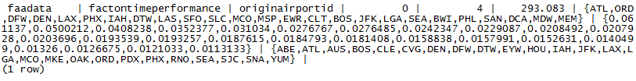
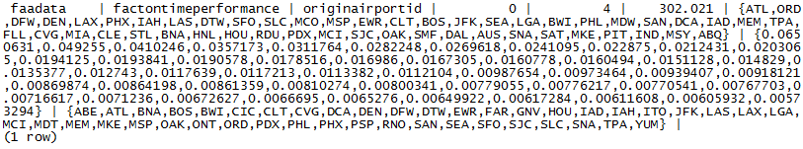
Effect of Updating the Statistics Value
pg_stats view of originairportid column in factontimeperformance table
Sampling size has increased, improving statistics for the column
Updated statistics on originairportid column
Notes:
In this example, the statistics for the originairportid column of the factontimeperformance table is displayed. The sampling is based on the statistics value of 25, so the database sampled enough rows to obtain 25 distinct values in the most_common_vals column.
Next, the statistics on the originairportid table is increased to 50 and the table analyzed. This requests that the analyzer increase the sampling size so that there are now up to 50 distinct values in the most_common_vals column. By increasing the sampling size, the query planner will have a better insight into the makeup of the values within the column. This type of action can be performed on columns that are used more often in WHERE clauses. While it increases the amount of time required for analyzing the table, it gives a more accurate description of the makeup of the column, potentially improving the performance for the query.

Slide 13


Updating the Total Number of Entries in a Table
Examination of the number of rows (tuples) and pages
Examination of the number of rows (tuples) and pages
Number of rows and pages is updated to accurately reflect newly added rows
Notes:
The number of rows and pages, or disk blocks, used by a table are stored in the pg_class table. This information is a component of statistics, used by the planner to build the query plan. The reltuples and relpages are not constantly updated and relies on the analysis performed by commands such as VACUUM, ANALYZE, and CREATE INDEX to update the values. As these values may be out of date, it could impact the final query plan generated for the table.
In this example, the number of rows is displayed as of the last ANALYZE. Separately, several thousand rows were added to the table. If the ANALYZE command is not executed, the pg_class table continues to display the now outdated number of rows in the table.
Executing the ANALYZE command updates the number of rows as well as the number of disk blocks occupied by those rows.

Slide 14
The gp_analyze_relative_error Parameter
The gp_analyze_relative_error server configuration parameter:
Sets the estimated acceptable error in the cardinality of the table; a value of 0.5 is equivalent to an acceptable error of 50%
Defaults to 0.25
Allows the number of rows sampled to be increased if the relative error faction is decreased
Is set in the following manner: gp_analyze_relative_error = .25
Notes:
The gp_analyze_relative_error server configuration parameter sets the estimated acceptable error in the cardinality of the table. A value of 0.5 is equivalent to an acceptable error of 50%. The default value is 0.25.
If the statistics collected are not producing good estimates of cardinality for a particular table attribute, decreasing the relative error fraction, or accepting less error, increases the number of rows sampled to determine the number of distinct non-null data values in a column. The number of distinct non-null data values in a column are stored in the stadistinct column of the pg_statistic table.
A larger target value will increase the time needed to do ANALYZE, but may improve the quality of the query planner’s estimates.

Slide 15
ANALYZE Best Practices
Consider the following:
For large data warehouse environments it may not be feasible to run ANALYZE on the entire database or on all columns in a table
Run ANALYZE for
Columns used in a JOIN condition
Columns used in a WHERE clause
Columns used in a SORT clause
Columns used in a GROUP BY or HAVING clause
Notes:
It is important to maintain accurate statistics for optimal query performance. In large data warehouse environments it may not be feasible to run ANALYZE on an entire database or table due to time constraints. In this scenario it is important to generate statistics on columns used in a:
JOIN condition
WHERE clause
SORT clause
GROUP BY or HAVING clause
ANALYZE requires only a read lock on the table, so may be run in parallel with other database activity though not recommended when performing loads, INSERT, UPDATE, DELETE, and CREATE INDEX operations. Run ANALYZE after load, INSERT, UPDATE, DELETE, and CREATE INDEX operations.

Slide 16
Wrapping Up
In this module we covered:
Collecting statistics about the database
Improving performance by using ANALYZE
Increasing sampling and statistics
Identifying when it is best to use ANALYZE
Notes:
This lesson discussed statistics and the need to provide updated statistics to the optimizer to more accurately predict the costs and time required to complete a query. The EXPLAIN ANALYZE and ANALYZE commands allow you to update metadata about tables, rows, and columns to improve the query plan that is generated by the optimizer. In addition to updating information on relations, increasing sampling size and statistics helps to fine tune the statistics collected on relations, which in turn can improve the query plan the optimizer generates.

